Slide 1

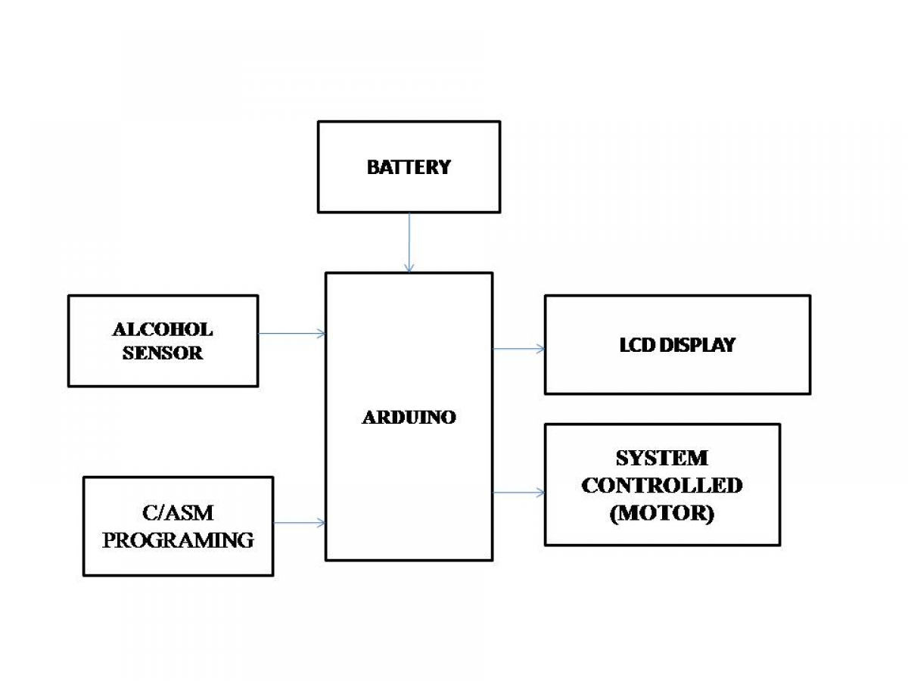
SMART HELMET SAFETY SYSTEM USING ATMEGA 32
Department of C.S.E and C.S.E. (AI)
Team No:A-16
Student Names:Harsh.Nesari
Mohd.Qadir Ternikar
Murnali.Bennalkar
Vanashree.Nandaganve
Problem statement
Methodology
h
Block Diagram
Motorcycle accidents are a significant cause of fatalities and injuries worldwide. These accidents often result from riders not wearing helmets, driving under the influence of alcohol, and not receiving timely medical assistance in the event of a fall. Despite regulations and awareness campaigns, many riders neglect safety measures, leading to severe consequences.
Develop circuit diagrams for connecting the alcohol sensor, ATmega 32, and other peripherals. Ensure proper power supply, signal conditioning, and grounding. Assemble the circuit on a breadboard Design a compact and secure method to integrate the alcohol sensor and electronics into the helmet without compromising comfort or safety.for initial testing. Verify connections and ensure the system is functional.Implement continuous monitoring routines to check the rider's alcohol levels in real-time.Develop simple indicators (LEDs, buzzers) to alert the rider about system status and alcohol detection results.By following this methodology, we can systematically develop a robust and reliable alcohol detection system for smart helmets, leveraging the capabilities of the ATmega 32 microcontroller. This approach ensures that the system is not only functional but also safe, user-friendly, and compliant with regulatory standards.
.
Objectives
Accurate Measurement of Alcohol Levels:
Implement a reliable alcohol sensor to detect the rider's breath alcohol concentration.
Ensure the sensor can distinguish between permissible and excessive alcohol levels based on legal limits.
.User-Friendly Operation:
Ensure the alcohol detection system is easy to use and does not cause inconvenience to the rider.
Implement a quick and non-intrusive breath analysis process.
.System Reliability and Durability:
Design the alcohol detection system to be robust and reliable under various environmental conditions (e.g., temperature, humidity).
Ensure the system is durable and maintains accuracy over extended periods of use.
Conclusions
The smart helmet safety system using ATmega 32 enhances motorcyclist safety through effective alcohol detection. It involves structured system design, hardware and firmware development, testing, and maintenance. Reliable sensors and real-time monitoring ensure the rider is sober before starting the motorcycle. Rigorous testing and compliance with safety standards guarantee accuracy and reliability. This system significantly reduces alcohol-related accidents, offering a user-friendly and effective safety solution for motorcyclists.
Components Used
1.AVR ATmega32 microcontroller for controlling and commanding the objects.
2.LCD to display the instructions.
3.MQ-3 is widely used to detect the alcohol.
4.Buzzer helps when the sensor detects alcohol levels above the threshold, the microcontroller activates the buzzer.
5.Resistor of 330kohm
6.DC motor
Microcontroller: Programming and Interfacing Project Worklet -2023-24

